Slide 1
Drawing Attention Using Better Charts Design
By: Hamza Tahir

Slide 2
Problems in Chart
The chart does not have a standard shape and uses circle, oval and square.
The data represented in numbers are confusing and it is difficult to keep track of them.
The line width are not in standard size and, are wider in some region and thinner in others.
These three points along with others makes it very difficult to follow through the chart.

Slide 3
1st Possible Solution
We can create a graph with simple boxes and arrows.
We can use different colors that would help to distinguish between each platform
For example:
Green for R,
Blue for Python,
Red for both Python and R
Grey for others

Slide 4
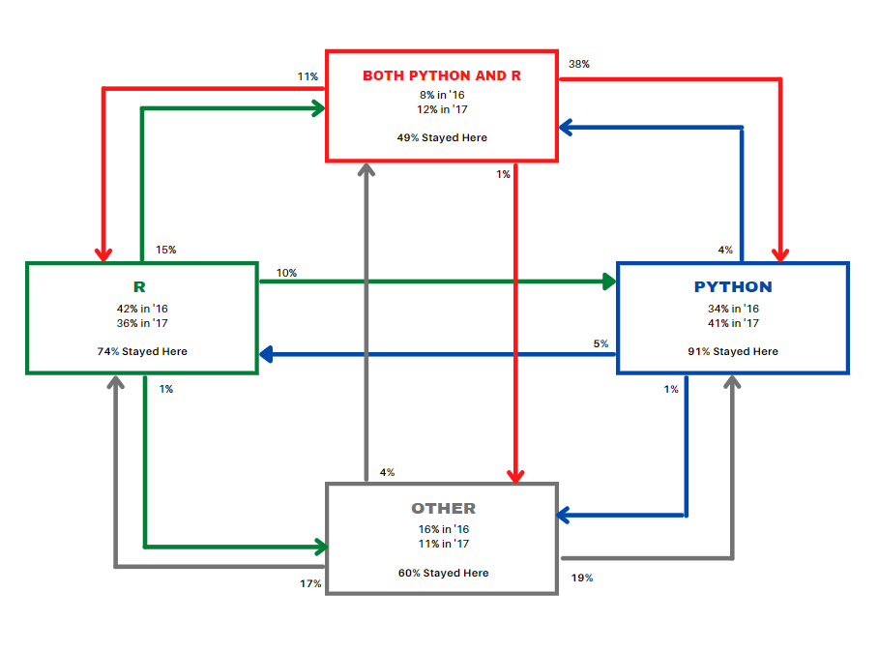
1st Possible Solution

Slide 5
2nd Possible Solution
To make the Graph more Simple we can create a Belt and Suspender Design.
By using only a single color and using text with bold and simple

Slide 6
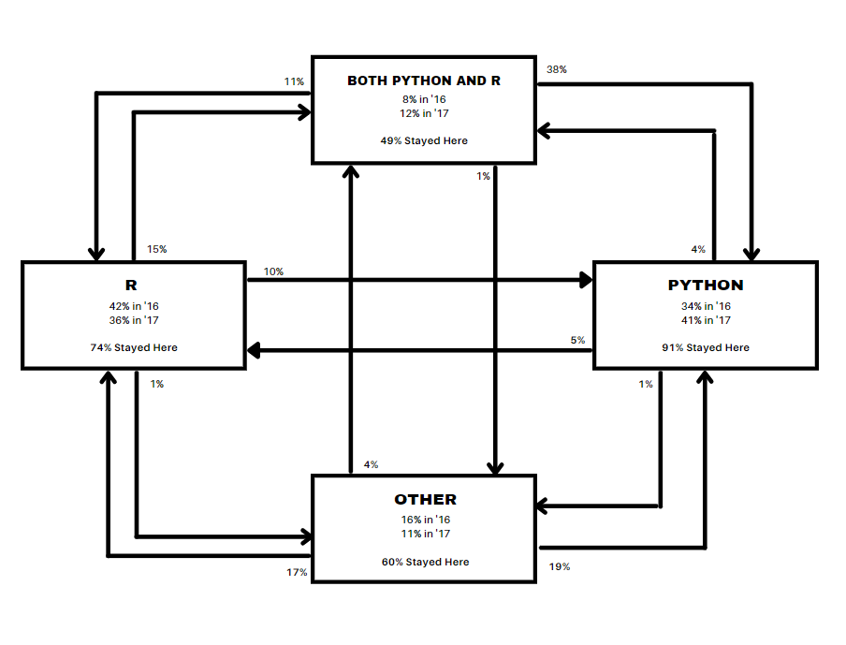
2nd Possible Solution

Slide 7
3rd Possible Solution
As we can see that Both R and Python can be concatenated together. So we use a Venn Diagram type chart that shows their Integration and then using arrows and text we can represent the whole chart in a much simple way.
Also Different Colors for different platforms are represented to distinguish between them easily.

Slide 8
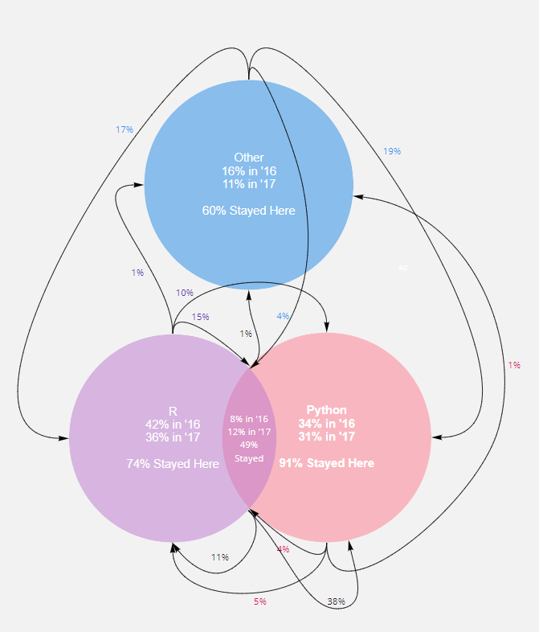
3rd Possible Solution

Slide 9
Conclusion
Charts can be represented in a simple and easy way we just have to find the right technique and moreover don’t try to get everything right the first time. Experiment with different ideas and techniques until you find a perfect match for your need.

Slide 10
Thank You

